Slide 1
THE OFFSHORE WIND WORKFORCE DEVELOPMENT PORTAL CONCEPT
OSW WFD Portal Concept Deck March 2023
rpsgroup.com

Slide 2
The Problem: It is hard to get data on OSW job creation
There is a significant financial penalty for failing to meet workforce development commitments
The country is counting on 30GW of OSW by 2030
Without the workforce, the goal is unattainable
States are counting on economic rewards and societal benefits to justify their investments in OSW
Billions being invested in workforce development
Developers are required to commit to workforce development results, with tens of millions of dollars on the line
For example, NYSERDA has baked accountability into the current OSW RFP
For example, the BOEM Bid Credits in the CA lease auction

Slide 3
The Solution: The Offshore Wind Workforce Development (OSW WFD) Portal
Measure, Manage and Report Real KPI Data
Provides developers with the data to effectively manage programs
Robust user acquisition strategy, personalized user experience, and customized user engagement capabilities
Developer has access to relevant user training and employment data
Enables (and streamlines) developer data reporting tasks
On-demand customizable reports
For example, our demo incorporates functional data alignment with Part VI-1 of the NYSERDA RFP Offer Data Form
The OSW WFD Portal is a powerful tool enhancing the effectiveness of your larger public outreach and workforce development strategy

Slide 4
Features and Benefits
For Registrants
A personalized “one stop shop” to find career resources tailored to their specific attributes and interests:
Certificate and degree education programs
Training and continuous education opportunities
Financial Aid
Employment Agencies
Employment Listings
Basic on-line OSW orientation training opportunities
Rewards for ongoing data sharing with the developer
For Developers
Real data to track and manage KPIs, such as:
User employment details
User demographic data
User interest career path data
Data for reporting to agencies and stakeholders on KPIs
Leverages existing programs and investments
Customization and optimization
Branding
Key geographies

Slide 5
OSW WFD PORTAL CONCEPT DEMONSTRATION
(STILLS FROM DEMO)
rpsgroup.com

Slide 6
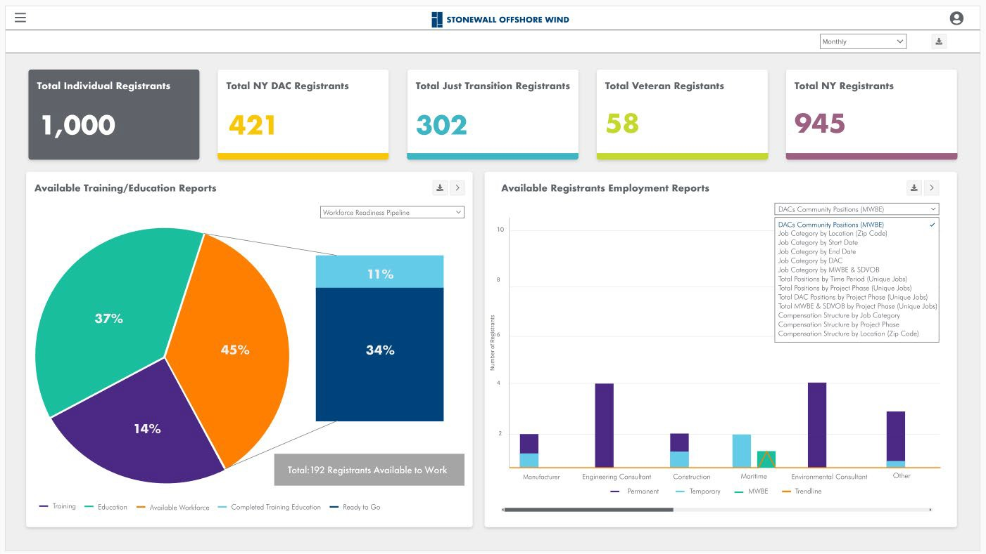
The primary purpose of the OSW WFD Portal is to get developers the data they need to manage and report on successful workforce development programs

Slide 7
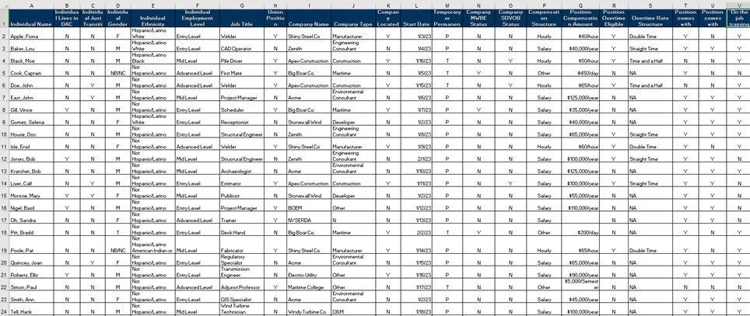
Between the registration information collected in the portal and status information gleaned through follow up questionnaires, developers will receive data needed to manage and report on their workforce development contribution.
Reports can be set up to correspond with reporting requirements

Slide 8
Example Strategies to Drive Registrants to OSW WFD Portal
We’ll work with your existing community and stakeholder engagement strategy to drive registrants to the OSW WFD Portal entrance on your project web site
This slide illustrates an example strategy for reaching potential OSW WFD Portal registrants in NYC Disadvantaged Communities (DAC)

Slide 9
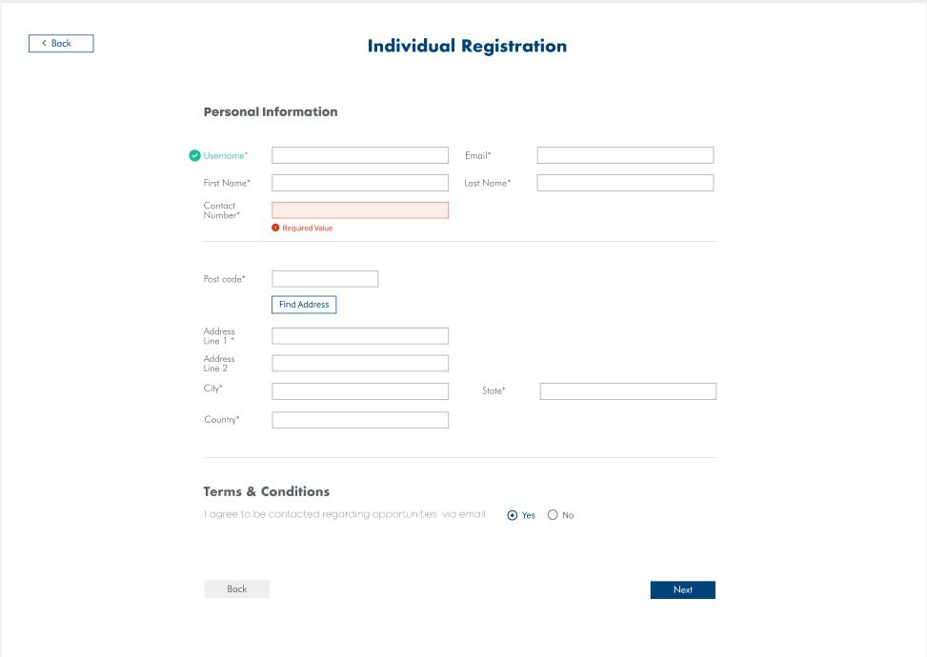
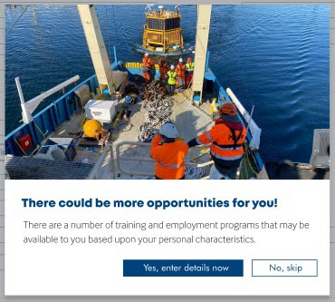
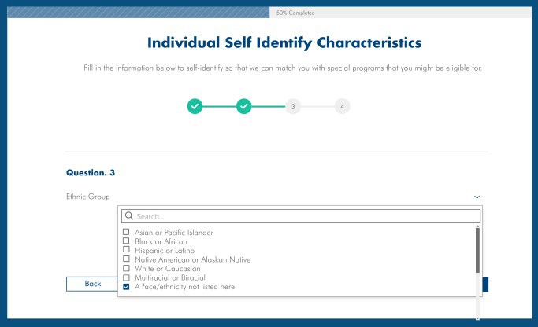
Example Individual Registration Pages
Step 1:
The individual shares basic information during registration
Step 2:
The individual is given the opportunity to share their special characteristics, to unlock more individualized opportunities, such as gender, race/ethnicity, education level, veteran status, etc.
All of this data is useful for measuring and managing workforce development initiatives

Slide 10
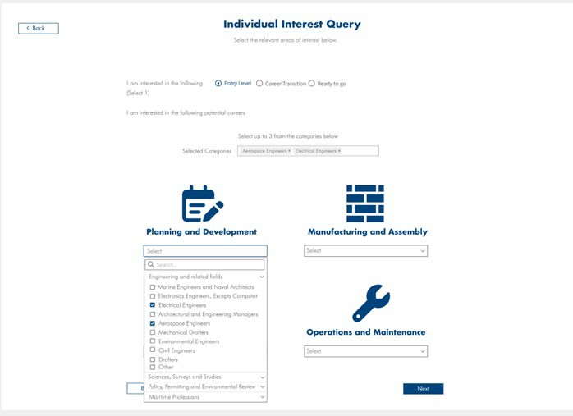
Example Individual Career Level and Interest Query
Individuals are then asked to self-identify:
Their work readiness level (Entry Level, Mid-Career Transition, or Ready to Work); and
Career categories of interest
Behind the scenes the robust OSW WFD Portal databases match the user’s career level, interest and characteristics to tailored workforce opportunities.

Slide 11
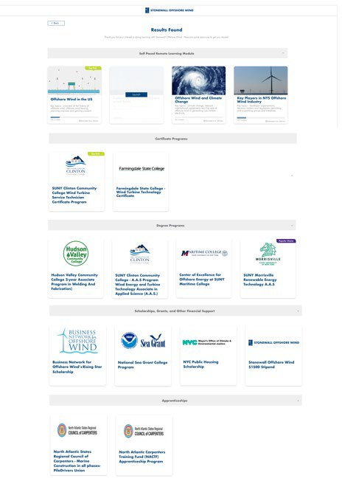
Example Individual Results Page
This example Result Page matches a recent high school grad who lives in NYC public housing to various programs in marine construction
On-line self-paced trainings
Certificate training programs
Degree programs
Financial aid
Apprenticeships
The results page for a more experienced worker might provide referrals for:
Continuous education
Union halls
Employment agencies
Job boards
Add footer text here

Slide 12
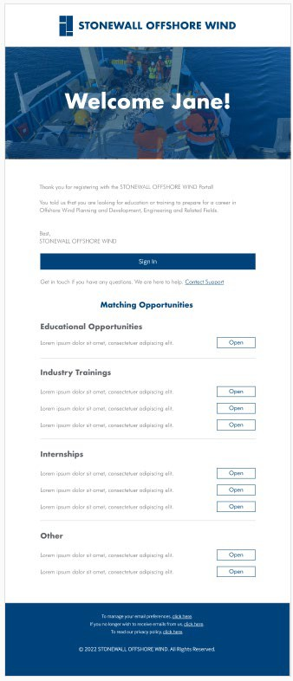
Through follow up email or text questionnaires, which registrants are rewarded to complete, registrants provide the elusive status data necessary for developers to report on workforce development progress.
Successful behavioral rewards programs use a variety of potential incentives:
Positive reinforcement
Gift cards
Points that can be collected and returned for gift cards or other items of value
Opportunity to participate in industry events, such as webinars, meet and greets with potential employers, etc.

Slide 13
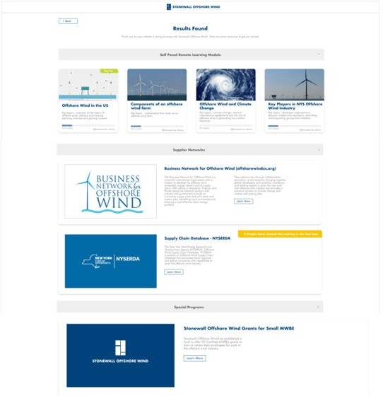
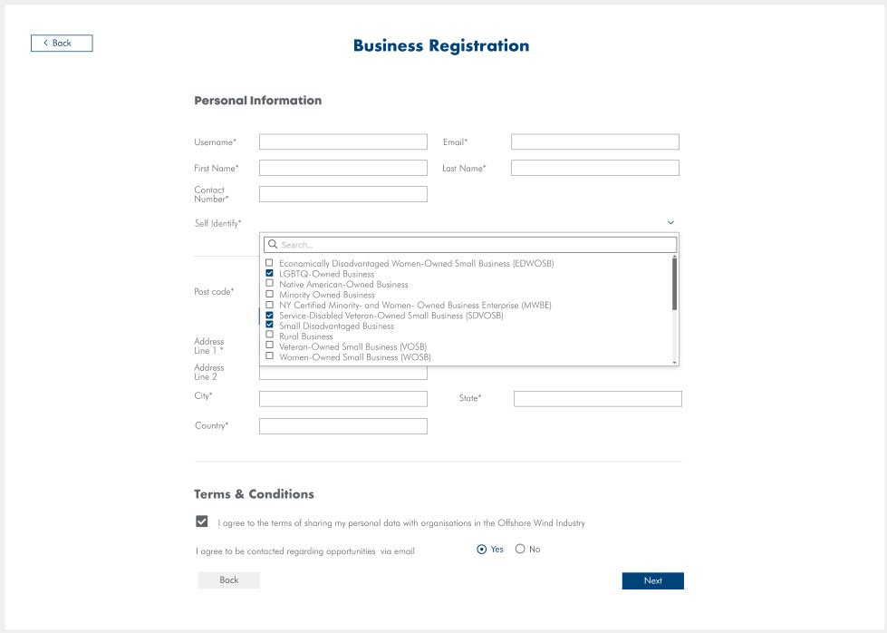
There is a similar process for businesses

Slide 14
THE TEAMING OPPORTUNITY
rpsgroup.com

Slide 15
Business Model
Customized Solution, Simple & Affordable Access
Hosted solution tailored to your needs
One-time fee to support setup and customization
Annual Subscription, includes:
Unlimited registrations
Unlimited admin accounts
RPS training credits
Benefits for early adopters!
Immediately relevant to planning for BOEM Leasing Credits and OREC/PPA Auctions obligations
Free Customization -- No Setup Fee
Discounted Subscription with a 3-year commitment
Ability to influence user experience and workflows

Slide 16
Next Steps
RPS can set up a live demonstration for your team
We’re eager to hear your feedback for improvements and optimizations, addressing your organizational needs
We are happy to welcome your company as an Early Adopter
Contact:
Troid.Edwards@RPSGroup.com
Vaishnavi.Ramesh@RPSGroup.com

